Slide 1

Vehicle Insurance Fraud Detection

Slide 2

Objective
The objective is to classify claims as fraud or non-fraud, so we don't have to waste time to analyse every claim by
assigning specialists
The goal is to develop and implement a fraud detection system that leverages advanced technologies such as data analytics, machine learning algorithms, and predictive model.

Slide 3
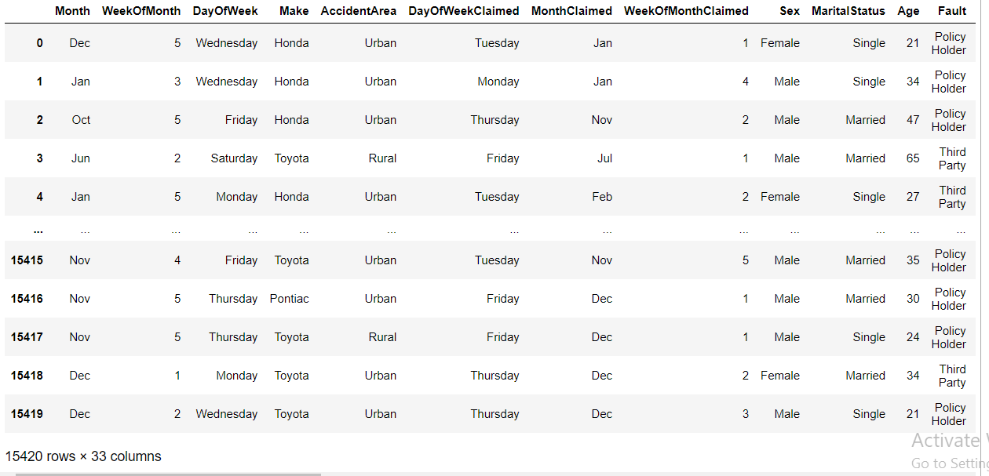
Dataset

Slide 4
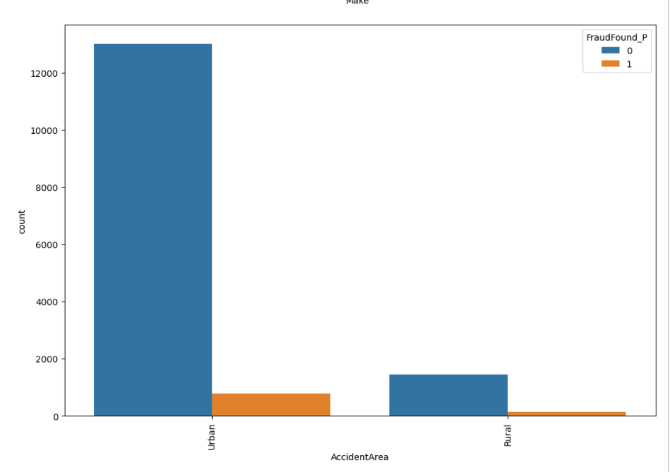
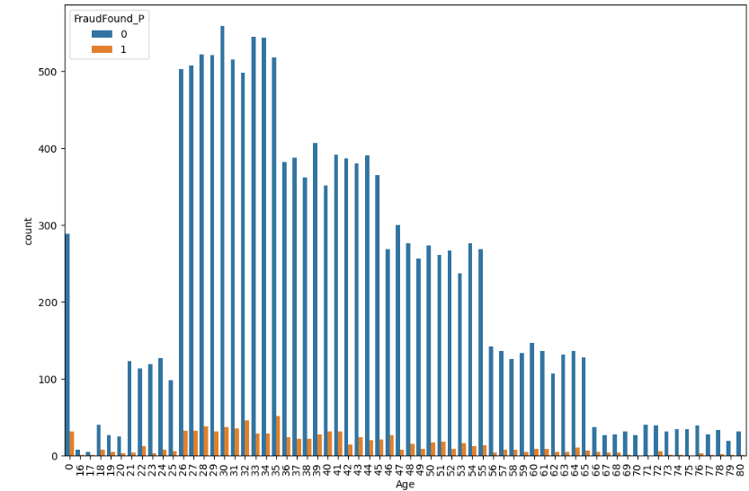
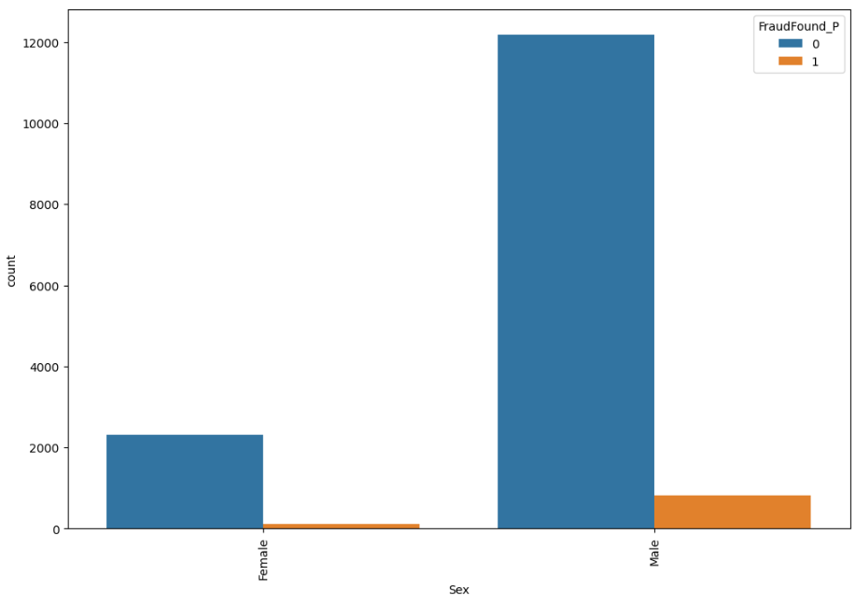
Exploratory Data Analysis
Most accidents occur in Urban areas and the remaining occur in Rural areas.
Most driver are male and than female
Most of the frauds has done in age of 26 to 45

Slide 5
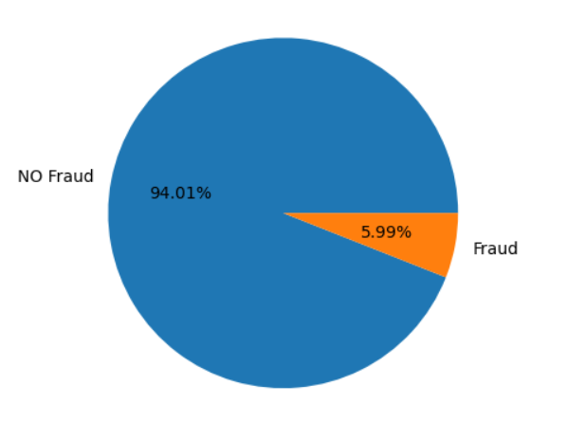
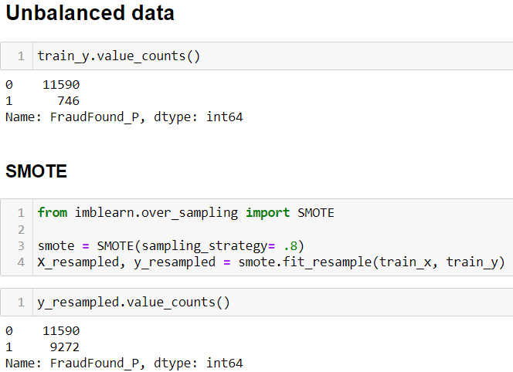
Challenges- CLASS IMBALANCE

Slide 6






TOOLS AND PLATFORM USED
Languages : Python, HTML, CSS
Platform : Jupyter Notebook, Visual Studio Code
Library Used : Numpy, Pandas, matplotlib, seaborn, Scikit-learn

Slide 7
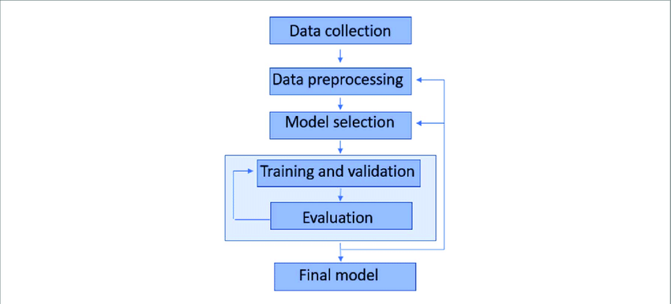
Machine Learning Work Flow

Slide 8
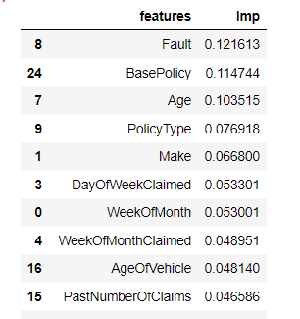
IMPORTANT VARIABLE

Slide 9

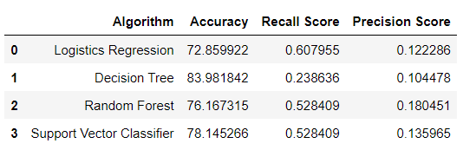
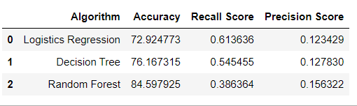
Machine Learning Models
Before Hyper parameter Tuning
After Hyper parameter Tuning

Slide 10

Advantages
Insurance company no need to assign specialists
Save cost and time
Reduce financial burden of fraudulent claims

Slide 11
Disadvantages
Recall score for class1 is less so some claim can not be detected

Slide 12
Conclusion
A Vehicle Insurance can be detected by ML algorithm and avoid the losses of company
Age 26 To 46, Sedan category car, which have maximum chances of fraud
In sport and utility category of car having very less chance of fraud

Slide 13
Thank You

